Slide 1

A Fiscal History of Ontario, 1867 to 2020: Income Elastic Spending or Displacement Effects?
Livio Di Matteo, Lakehead University
Paper prepared for the Canadian Network for Economic History Meetings, University of New Brunswick, April 29-30, 2022.

Slide 2
Summary
Data from the Finances of the Nation government finance database for Ontario for the period 1966 to 2020 is combined with Ontario budgetary data for the period 1867 to 1965 to provide an overview of the evolution of Ontario revenues and expenditures from 1967 to the present.
Analysis finds four distinct periods - 1867 to 1914, 1914 to 1945, 1945 to 1974 and 1974 to the present – marking distinct shifts to new and higher levels of real per capita Ontario government spending and revenues.
Regression analysis finds Ontario government spending driven by a combination of both demand side factors and supply side factors with evidence for both Wagner’s Law and Peacock-Wiseman as drivers of government expenditure in Ontario.

Slide 3
Real Per Capita Revenues and Spending

Slide 4
Average Growth Rates

Slide 5
Public Sector Size in Ontario

Slide 6
Comparing with the Feds

Slide 7
Deficits

Slide 8
Debt

Slide 9
Patterns of Real Per Capita Spending
Province Building from 1867 to 1914;
Wars, Booms and Depressions, 1914 to 1945;
The Social Welfare State from 1945 to 1974; and
Maturity and Slowdown from 1974 to 2020.

Slide 10
Approaches to Explaining Public Sector Growth
Wagner’s Law
  Public expenditure grows faster than output in industrializing countries because government expenditures for general government, protection, culture, welfare, and provision of services are highly income elastic
Peacock and Wiseman
  Public expenditure growth is driven by what taxpayers consider to be tolerable levels of taxation; tolerance grows during times of national or social crisis. As a result, the public sector has grown in a step-like fashion of abrupt jumps and long plateaus driven by crises such as war.

Slide 11
Regressions
A simple regression model of the determinants of Ontario government spending is specified as:
  G_{t}=a + bY_{t} + cZ_{t} + u_{t}
Where G is government spending, Y is per capita income and Z represents a set of additional variables including shift or displacement variables. Two versions of the government spending dependent variable are used: first, real per capita Ontario government expenditures in 2020 dollars and second, the ratio of Ontario government expenditure to GDP.

Slide 12
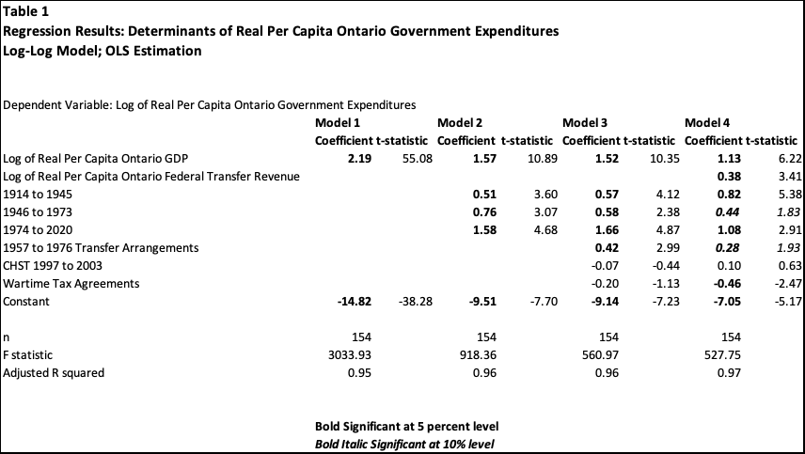
Results -I

Slide 13
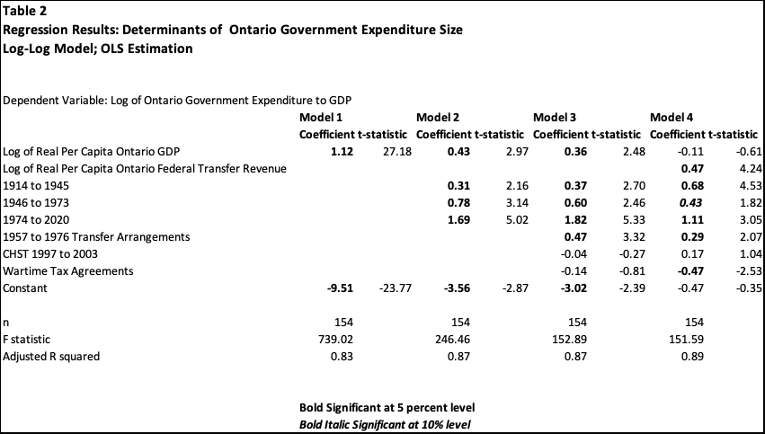
Results-II

Slide 14
Conclusions
The analysis finds government expenditures trends divided into four periods: 1867 to 1914, 1914 to 1945, 1945 to 1974 and 1974 to the present.
These four periods each appear to mark distinct shifts to new and higher levels of real per capita Ontario government spending and revenues and represent support for Peacock-Wiseman structural shifts in spending.
At the same time, spending is also income elastic over the long term which is evidence of a Wagner’s Law type mechanism in driving expenditure growth.
Government spending in Ontario has been driven by the demand for programs and services in response to rising income and shifts fueled by both growing own source revenues as well as changes in federal transfer programs and regimes.

